Slide 1
A GUI framework for PySAL
Team members: Dae-hyun You, Sanjay Paul, Jianhua Huang, Ki-hwan Seo, Evan Palmer
GPH 598: Geocomputation, Fall 2011

Slide 2
General Task
To incorporate matplotlib libraries into PySAL via a GUI framework
  matplotlib is...
  PySAL is...
  A way to bring these together would be of value to PySAL users who otherwise would have to go through a few more steps and hassle to produce publishable graphs and figures, etc.

Slide 3
What we did...
We wrote code that married a matplotlib generated scatterplot, box-plot, and histogram with PySAL’s Moran’s I and Local Moran’s I functions.
Example dataset from PySAL -- Homicide rates for 78 counties in/around St. Louis, 1988-1993.

Slide 4
What our code does...
Displays a basic interface (the GUI)
Allows user to import data (.gal, .shp, .txt files, etc.) and choose a specific attribute category
Displays map
Calls PySAL’s Moran’s I and Local Moran’s I (p-value) functions

Slide 5
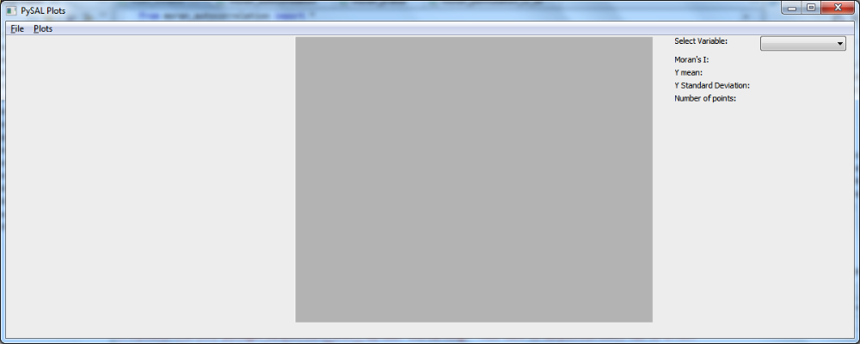
Blank interface

Slide 6
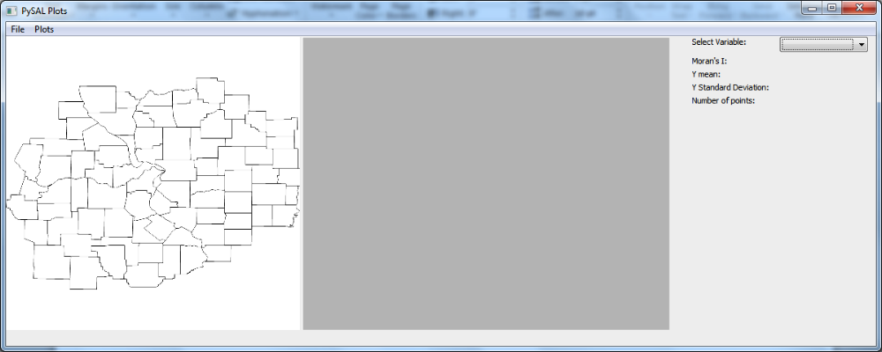
…after importing data

Slide 7
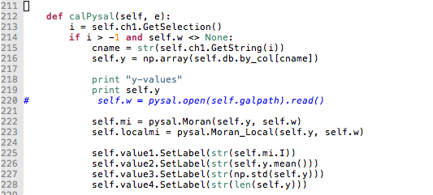
PySAL runs the calculations

Slide 8
Then our code...
Calls for matplotlib code and displays results via user-selected pull-down menus:
  Autocorrelation in a scatterplot
  Number of events and outliers in a box-plot
  Distribution of real p-value compared to pseudo p-value in a histogram
  Map of study area (...still under development)
  Relevant statistics (mean value, std-dev value, n-value, etc.)

Slide 9
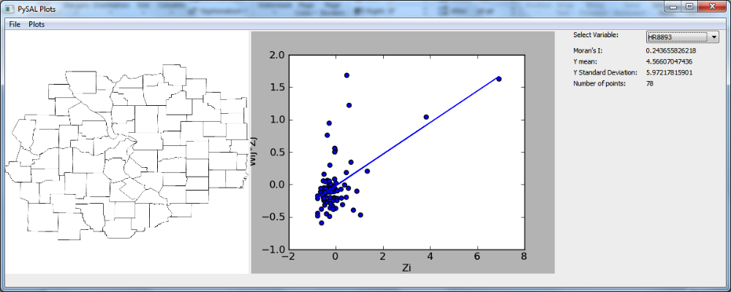
Scatter plot

Slide 10
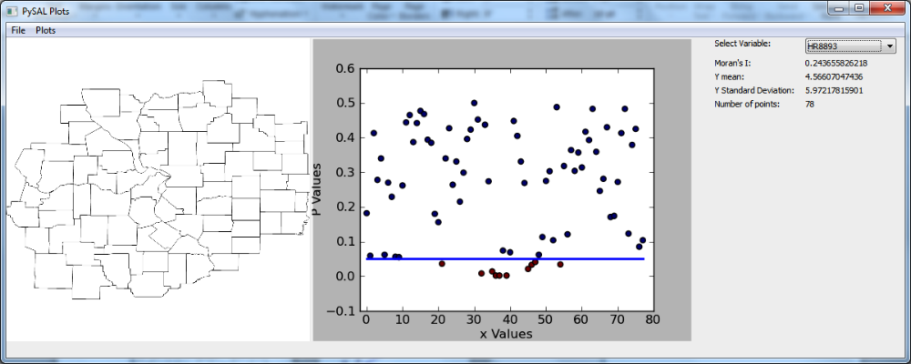
Scatter plot

Slide 11
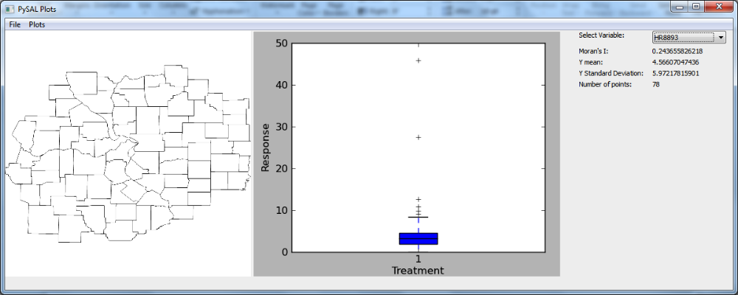
Box plot

Slide 12
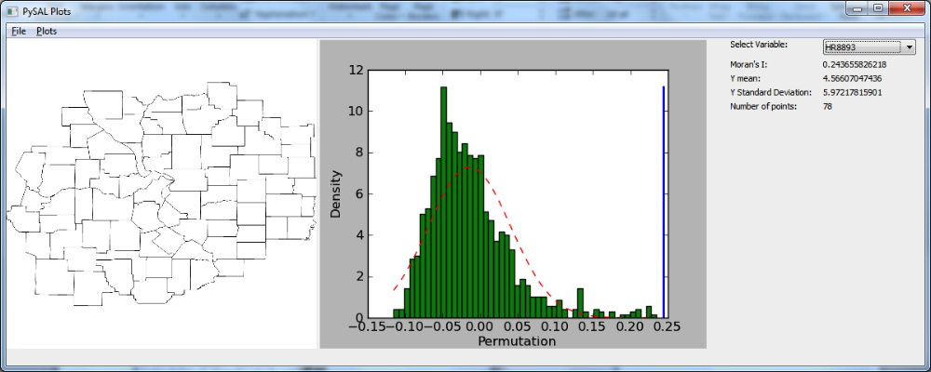
Histogram

Slide 13
It works!
Our basic code can be expanded and used as an example of how to bring in many more display capabilities of Matplotlib with PySAL functions.

Slide 14
Let’s actually run the program!
Buckle up…

